Slide 1

Mobile Computing
Learning Unit 1 1.2 Android Studio
Moaath Alrajab

Slide 2
Learning Unit 1
1.1 Introduction
Android History
Android Architecture
Getting Started
1.2 Android Studio
IDE parts
Creating a project
Installing required plugins
1.3 Android Application
Concept and components
Manifest file

Slide 3
Meet Android Studio
Android Studio is the official Integrated Development Environment (IDE) for Android app development, based on IntelliJ IDEA .
On top of IntelliJ's powerful code editor and developer tools, Android Studio offers even more features that enhance your productivity when building Android apps, such as:
A flexible Gradle-based build system
A fast and feature-rich emulator
Credit: Kirk Scott

Slide 4
A unified environment where you can develop for all Android devices
Instant Run to push changes to your running app without building a new APK
Code templates and GitHub integration to help you build common app features and import sample code
Extensive testing tools and frameworks
Lint tools to catch performance, usability, version compatibility, and other problems
C++ and NDK support
Built-in support for Google Cloud Platform, making it easy to integrate Google Cloud Messaging and App Engine

Slide 5
Project Structure
Each project in Android Studio contains one or more modules with source code files and resource files.
Types of modules include:
Android app modules
Library modules
Google App Engine modules
[See the following overhead]

Slide 6
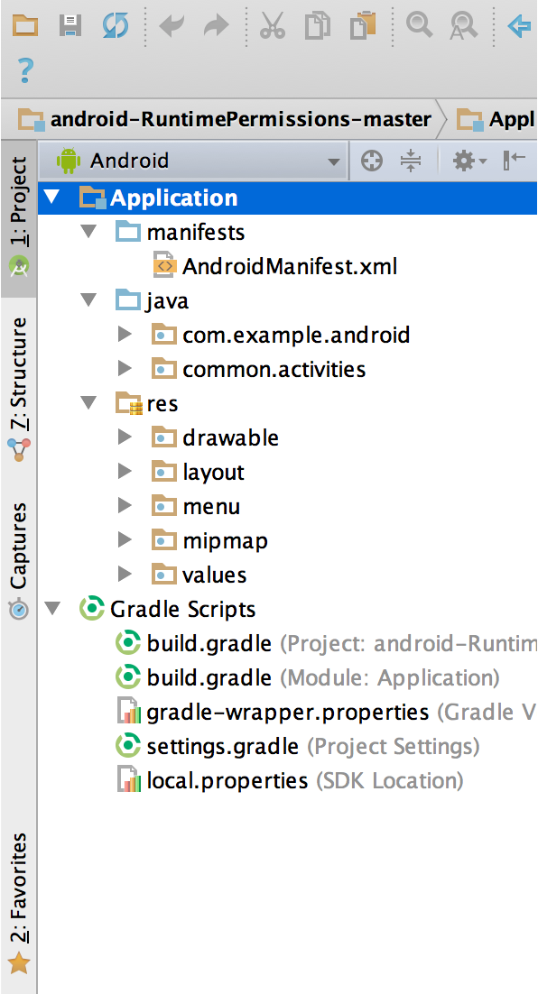
By default, Android Studio displays your project files in the Android project view, as shown in figure 1.

Slide 7
This view is organized by modules to provide quick access to your project's key source files.
All the build files are visible at the top level under Gradle Scripts and each app module contains the following folders:
manifests: Contains the AndroidManifest.xml file.
java: Contains the Java source code files, including JUnit test code.
res: Contains all non-code resources, such as XML layouts, UI strings, and bitmap images.
The Android project structure on disk differs from the IDE flattened representation.
To see the actual file structure of the project, select Project from the Project dropdown (in figure 1, it's showing as Android).

Slide 8
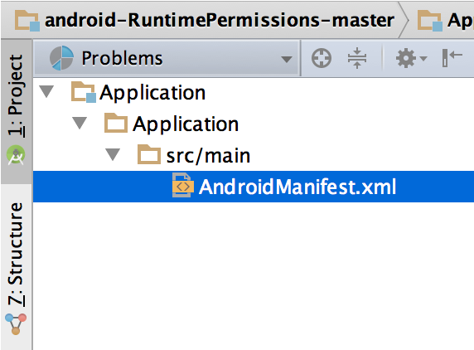
You can also customize the view of the project files to focus on specific aspects of your app development.
For example, selecting the Problems view of your project displays links to the source files containing any recognized coding and syntax errors, such as a missing XML element closing tag in a layout file.

Slide 9
The User Interface
The Android Studio main window is made up of several logical areas identified in figure 3.
[1. The toolbar
2. The navigation bar
3. The editor window
4. Tool windows
5. The status bar

Slide 10
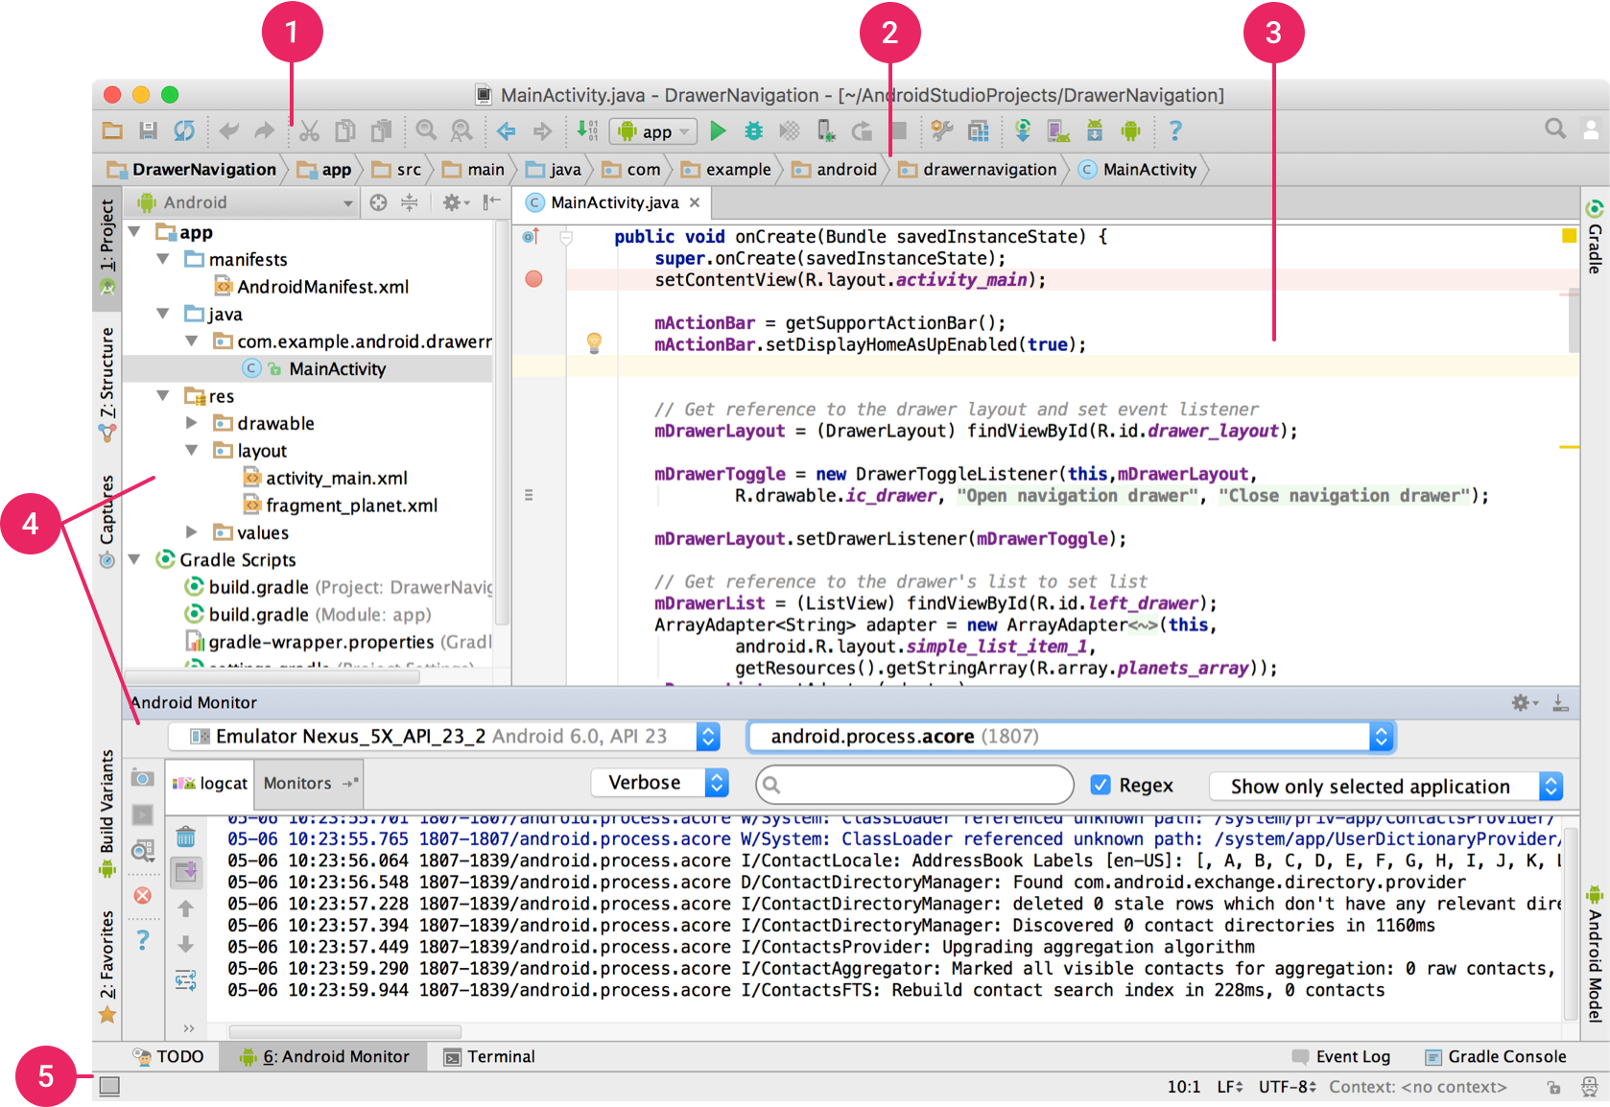

Slide 11
The toolbar lets you carry out a wide range of actions, including running your app and launching Android tools.
The navigation bar helps you navigate through your project and open files for editing.
It provides a more compact view of the structure visible in the Project tool window.
The editor window is where you create and modify code.
Depending on the current file type, this window can change.
For example, when viewing a layout file, the editor window displays the layout editor and offers the option to view the corresponding XML file.

Slide 12
Tool windows give you access to specific tasks like project management, search, version control, and more.
You can expand them and collapse them.
The status bar displays the status of your project and the IDE itself, as well as any warnings or messages.
You can organize the main window to give yourself more screen space by hiding or moving toolbars and tool windows.
You can also use keyboard shortcuts to access most IDE features.

Slide 13
Searching the IDE
At any time, you can search across your source code, databases, actions, elements of the user interface, and so on, by double-pressing the Shift key, or clicking the magnifying glass in the upper right-hand corner of the Android Studio window.
This can be very useful if, for example, you are trying to locate a particular IDE action that you have forgotten how to trigger.

Slide 14
Tool Windows
Instead of using preset perspectives, Android Studio follows your context and automatically brings up relevant tool windows as you work.
By default, the most commonly used tool windows are pinned to the tool window bar at the edges of the application window.
To expand or collapse a tool window, click the tool’s name in the tool window bar.
You can also drag, pin, unpin, attach, and detach tool windows.

Slide 15
***Definitely Useful: Restoring the Default Layout***
To return to the current default tool window layout, click Window > Restore Default Layout or customize your default layout by clicking Window > Store Current Layout as Default.
[Note: Whether you commit this to memory or not, it’s important to be able to muddle through the menu in order to bring back windows that you’ve accidentally lost.]

Slide 16
To show or hide the entire tool window bar, click the window icon in the bottom left-hand corner of the Android Studio window.
To locate a specific tool window, hover over the window icon and select the tool window from the menu.

Slide 17
***For Power-User Wannabes***
It seems unlikely that most people would master the keyboard shortcuts and other items shown on the following overheads unless they went down the Android Studio rabbit hole
However, the list may have value as a semi-comprehensive introduction to some of the environment’s capabilities
A few of the items listed are definitely useful

Slide 18
You can also use keyboard shortcuts to open tool windows. Table 1 lists the shortcuts for the most common windows.
Tool Window | Windows and Linux | Mac
Project | Alt+1 | Command+1
Version Control | Alt+9 | Command+9
Run | Shift+F10 | Control+R
Debug | Shift+F9 | Control+D
Android Monitor | Alt+6 | Command+6
Return to Editor | Esc | Esc
Hide All Tool Windows | Control+Shift+F12 | Command+Shift+F12

Slide 19
If you want to hide all toolbars, tool windows, and editor tabs, click View > Enter Distraction Free Mode.
This enables Distraction Free Mode.
To exit Distraction Free Mode, click View > Exit Distraction Free Mode.
You can use Speed Search to search and filter within most tool windows in Android Studio.
To use Speed Search, select the tool window and then type your search query.

Slide 20
Code Completion
Android Studio has three types of code completion, which you can access using keyboard shortcuts.

Slide 21
***Code completion is definitely useful, but as an eternally beginning programmer, quite often I find it to be a distraction***
Type | Description | Windows and Linux | Mac
Basic Completion | Displays basic suggestions for variables, types, methods, expressions, and so on. If you call basic completion twice in a row, you see more results, including private members and non-imported static members. | Control+Space | Control+Space
Smart Completion | Displays relevant options based on the context. Smart completion is aware of the expected type and data flows. If you call Smart Completion twice in a row, you see more results, including chains. | Control+Shift+Space | Control+Shift+Space
Statement Completion | Completes the current statement for you, adding missing parentheses, brackets, braces, formatting, etc. | Control+Shift+Enter | Shift+Command+Enter

Slide 22
Navigation
Here are some tips to help you move around Android Studio.
Switch between your recently accessed files using the Recent Files action.
Press Control+E (Command+E on a Mac) to bring up the Recent Files action.
By default, the last accessed file is selected.
You can also access any tool window through the left column in this action.

Slide 23
View the structure of the current file using the File Structure action.
Bring up the File Structure action by pressing Control+F12 (Command+F12 on a Mac).
Using this action, you can quickly navigate to any part of your current file.

Slide 24
Navigate to a file or folder using the Navigate to File action.
Bring up the Navigate to File action by pressing Control+Shift+N (Command+Shift+O on a Mac).
To search for folders rather than files, add a / at the end of your expression.

Slide 25
Navigate to a method or field by name using the Navigate to Symbol action.
Bring up the Navigate to Symbol action by pressing Control+Shift+Alt+N (Command+Shift+Alt+O on a Mac).
Find all the pieces of code referencing the class, method, field, parameter, or statement at the current cursor position by pressing Alt+F7.

Slide 26
2.2 “Update the IDE and Tools”
Things may have gotten better than in the past, but this is the voice of experience speaking:
It can be a mistake to accept development environment updates during the course of the semester (ask before update)
It is possible that system updates will cause something which was previously working not to work…

Slide 27
In general, you should just be able to install the latest stable release, and there is no particular need to update after that
It is certainly not advisable to use anything but a stable release
Especially since the hardware devices we’re using are not the most recent, the latest updates to Android should be of no consequence to us

Slide 28
Having given the preliminary warning, it’s worth knowing how updates are accomplished
It is always possible that you will want or need to update at some point
You may also want to know more so that you can protect yourself from unwanted updates
The online documentation follows

Slide 29
Once you install Android Studio, it's easy to keep the Android Studio IDE and various SDK tools up to date with automatic updates for Android Studio and the Android SDK Manager.

Slide 30
Android Studio Update Channels
Android Studio notifies you with a small bubble dialog when an update is available for the IDE, but you can manually check for updates by clicking Help > Check for Update (on Mac, Android Studio > Check for Updates).
Updates for Android Studio are available from the following release channels:

Slide 31
Canary Channel: These are bleeding-edge releases, updated roughly weekly.
Although these builds are subject to more bugs, they do get tested and they want to offer early access so you can try new features and provide feedback.
This channel is not recommended for production development.

Slide 32
Dev Channel: These are hand-picked canary builds that survived a full round of internal testing.
Beta Channel: These are release candidates based on stable canary builds, released to get feedback before going into the stable channel.
Stable Channel: The official stable release that is available for download at developer.android.com/studio.

Slide 33
By default, Android Studio offers updates from the Stable Channel.
If you'd like to try one of the other versions of Android Studio—known collectively as the Preview Channels—you can choose to receive updates from one of those instead.

Slide 34
If your system crashes midway through the semester and you have to re-install:
Most likely you will just take the latest stable version, even if it’s later than the one you installed initially
If you remember the version you originally installed, it may be possible to re-install it
As you recognize, either way, you may have follow-on problems as a result

Slide 35
***So, there’s no real reason to mess with this…***
To change your update channel, proceed as follows:
Open the Preferences window by clicking File > Settings (on Mac, Android Studio > Preferences).
In the left panel, click Appearance & Behavior > System Settings > Updates.
Be sure that Automatically check for updates is checked, then select a channel from the drop-down list (see figure 1).
Click Apply or OK.
[See the following overhead]

Slide 36
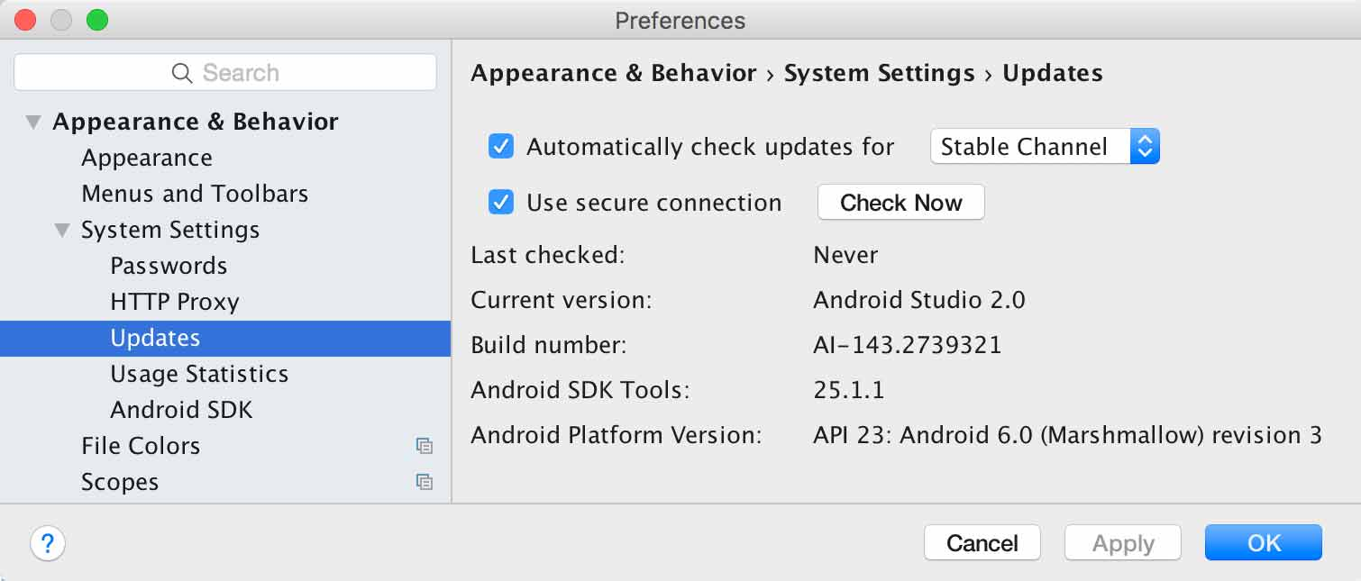

Slide 37
Android SDK Tool Updates
The Android SDK Manager provides the SDK tools, platforms, and other components you need to develop your apps.
To open the SDK Manager, click Tools > Android > SDK Manager or click SDK Manager in the toolbar.
When an update is available for a package you already have, a dash appears in the check box next to the package.

Slide 38
To update an item or install a new one, click the check box so it shows a checkmark.
To uninstall a package, click to clear the check box.
Pending updates are indicated in the left column with a download icon.
Pending removals are indicated with a red cross.
To update the selected packages, click Apply or OK, then agree to any license agreements.
[See the following overhead]

Slide 39
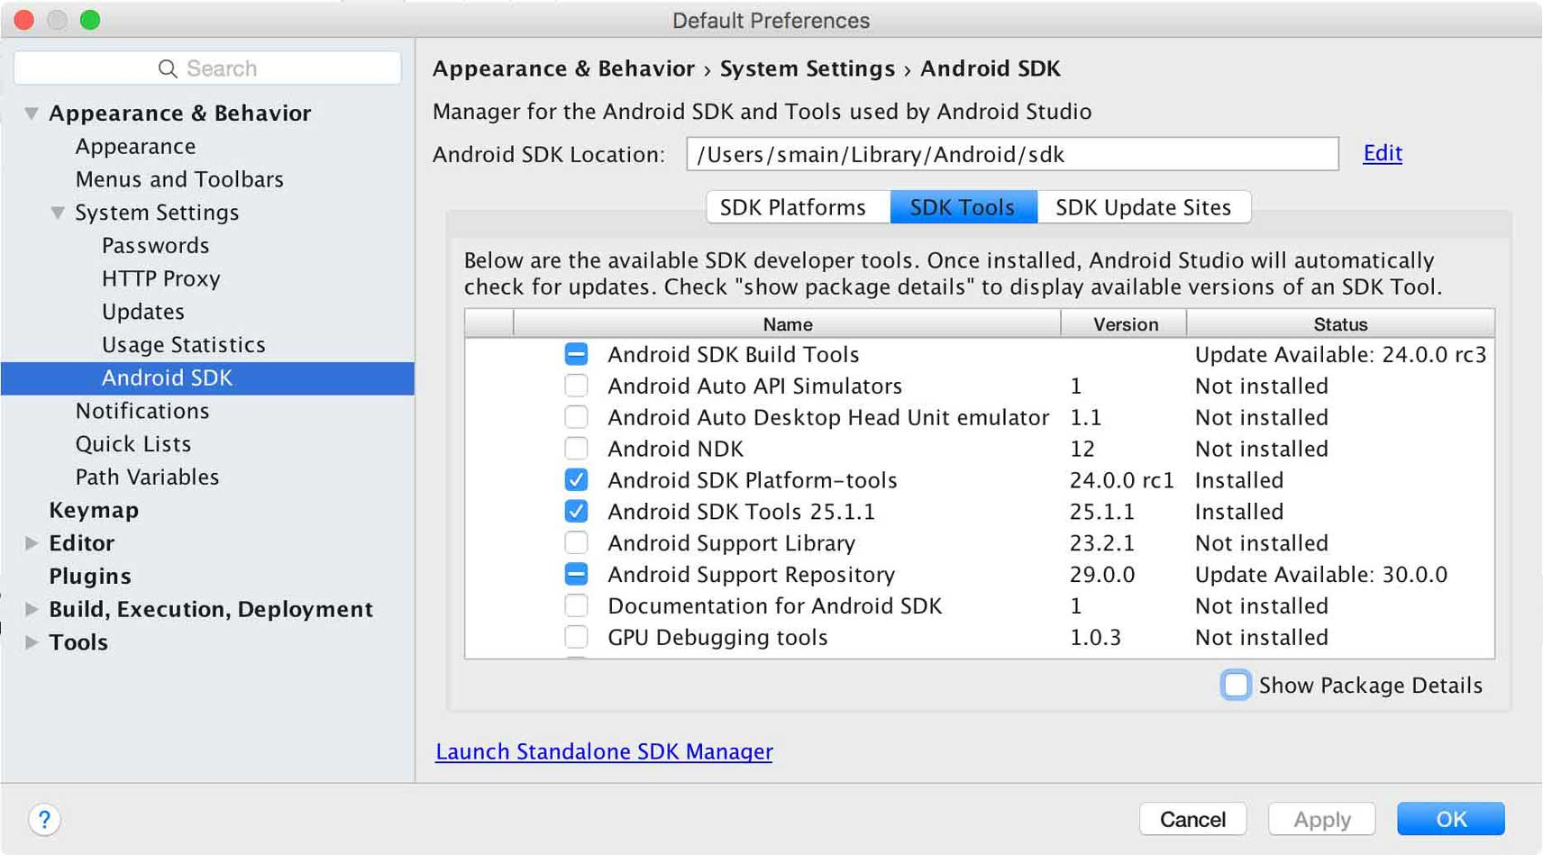

Slide 40
Note on Android Studio
In the past, making sure you had the right drivers for a device attached to your development machine could be an issue
It was the one critical thing that would require going through the update interface
It appears to go much more smoothly now
However, problems are always possible

Slide 41
2.3 “Workflow Basics”
This topic is very general and should be “non-threatening”
The idea is that there is a logical order of activities, a path to be followed, in order to go from an idea to an implementation
There’s no harm in a little high level visualization of what that path consists of

Slide 42
Developer Workflow Basics
The workflow to develop an app for Android is conceptually the same as other app platforms.
However, to efficiently build a well-designed app for Android, you need some specialized tools.
The following list provides an overview of the process to build an Android app and includes links to some Android Studio tools you should use during each phase of development.

Slide 43
1. Set up your workspace
This is the phase you probably already finished: Install Android Studio and create a project.
This is your first homework as of this Learning Unit 1.
For a walkthrough with Android Studio that teaches some Android development fundamentals, also check out the guide to Building Your First App.

Slide 44
2. Write your app
Now you can get to work.
Android Studio includes a variety of tools and intelligence to help you work faster, write quality code, design a UI, and create resources for different device types.
For more information about the tools and features available, see Write Your App.

Slide 45
3. Build and run
During this phase, you build your project into a debuggable APK package that you can install and run on the emulator or an Android-powered device.
For more information about how to run your code, see Build and Run Your App.
You can also begin customizing your build.
For example, you can create build variants that produce different types of APKs from the same project, and shrink your code and resources to make your APK file smaller.
For an introduction to customizing your build, see Configure Your Build.

Slide 46
4. Debug, profile, and test
This is the iterative phase in which you continue writing your app but with a focus on eliminating bugs and optimizing app performance.
Of course, creating tests will help you in those endeavors.
For information about basic debugging tasks, read Debug Your App and Write and View Logs.
To view and analyze various performance metrics such as memory usage, network traffic, CPU impact, and more, use Android Monitor.

Slide 47
5. Publish
When you're ready to release your app to users, there are just a few more things to consider, such as versioning your app and signing it with a key.
For more information, see the Publishing Overview.

Slide 48
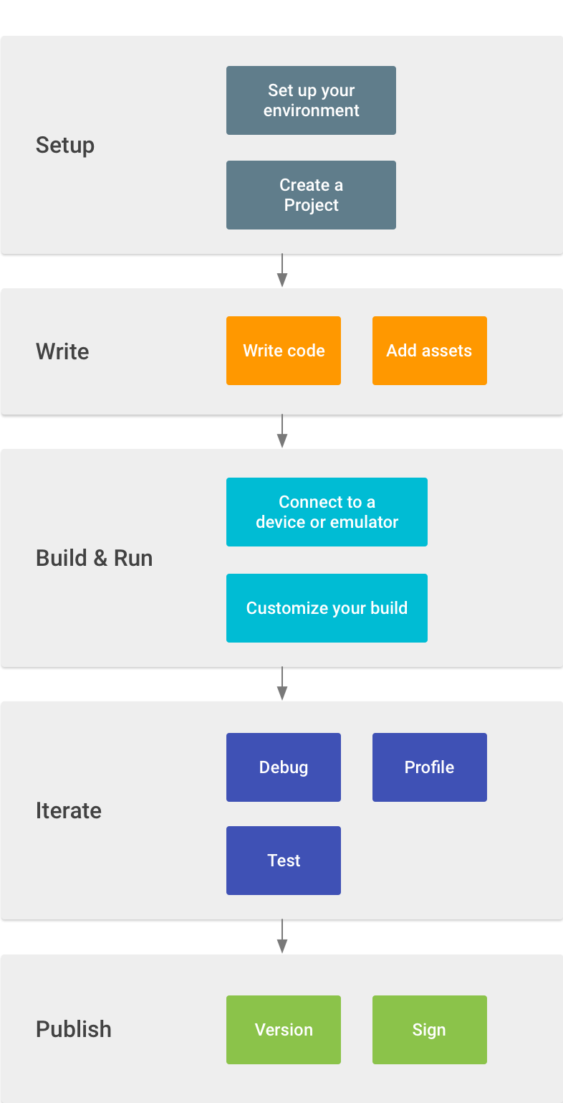

Slide 49
Concluding Comments
You are probably already familiar with the repetitive, cyclical nature of code development
You are constantly having to go back and debug, fix old features, and add new ones
Code, run, debug repeat
A colorful box diagram makes it look like fun rather than frustration ☺

Slide 50
The final step, publishing, is an option
The typical student project is not something that is going to acquire a mass, paying audience, but the principle is important and valid
Once you learn how to use Android, the potential is there to create something other people might want
GooglePlay provides a means for making it available to anyone in the world
In the vast infrastructure of Android, hardware, telecommunications, development software, etc., this is where you might fit in:
App developer

Slide 51
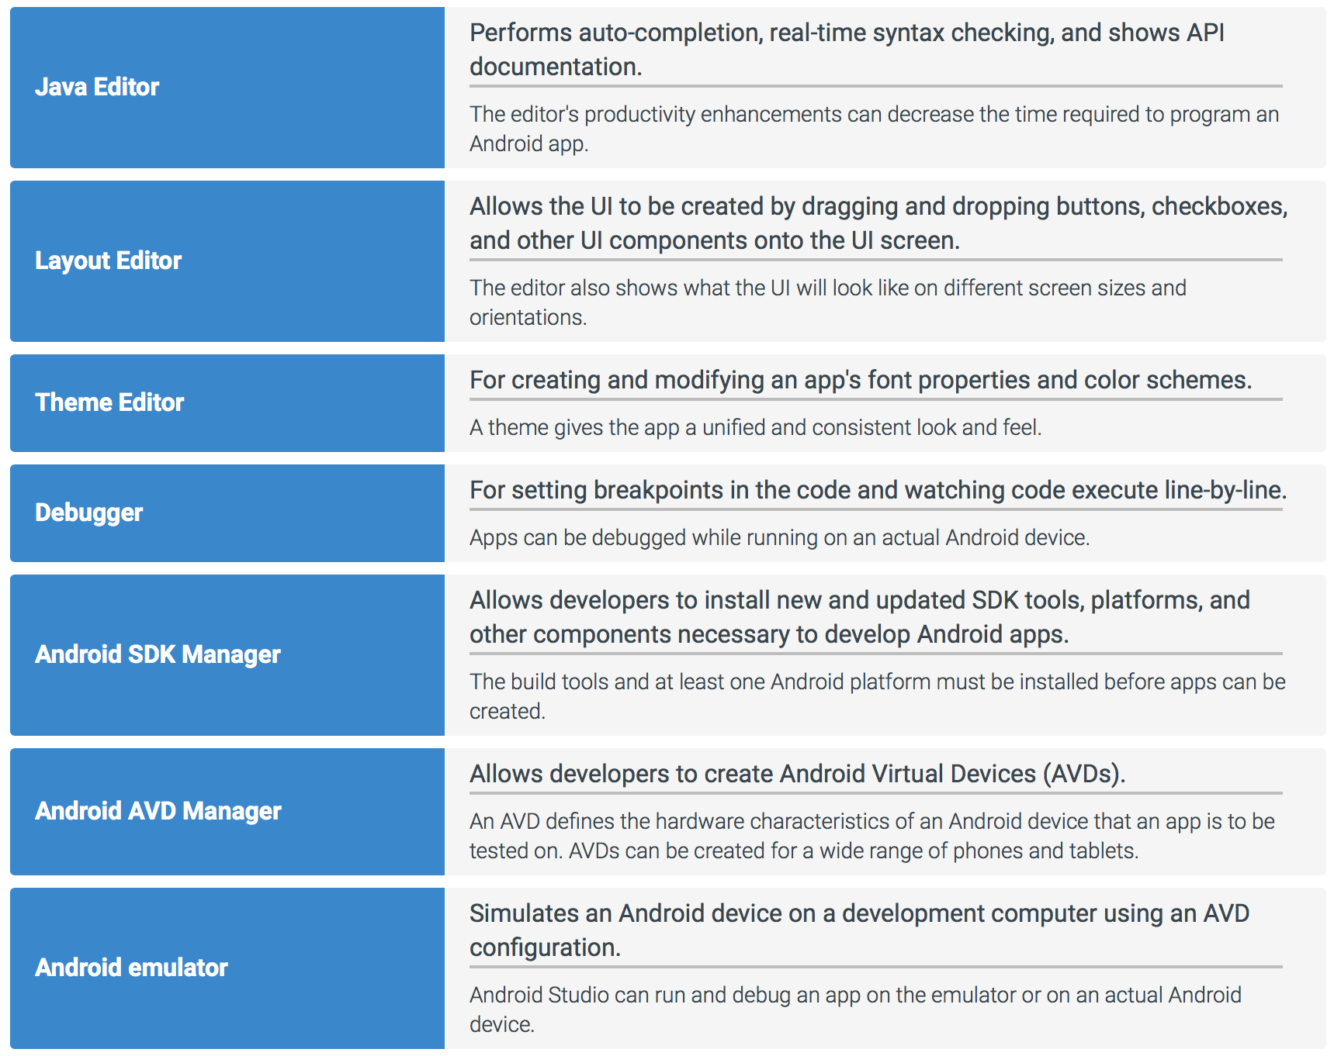

Slide 52
Next
1.3 Android Application

